Slide 1
WSFS EIP Domain Driven Design (DDD)
Discussion Document
DRAFT
April 28, 2020
Confidential Information for the sole benefit of the recipient

Slide 2
Objective
To discuss the following:
Domain driven design
Domain model
Guiding Principles
Approach on how to map APIs to the various domains
Confidential Information for the sole benefit of the recipient
Draft - For Final Review

Slide 3
What is Domain Driven Design?
Domain Driven Design (DDD) is a technique for developing APIs that focuses on collaboration between technical, business and domain experts
DDD is achieved by defining a domain model that is constantly evolving
Domain model helps you map APIs to a particular business capability with the intent that every API is built ultimately to serve a particular business need
The high level domain model that we will review today is based on global banking standard “BIAN” (Banking Industry Architecture Network)
Confidential Information for the sole benefit of the recipient
Draft - For Final Review

Slide 4
Domain Model - High Level
Users
Customers
Employees
Partners & Public
Channels
Voice Banking
Mobile
Online
Tablet
IVR
Contact Center
Branch
Reference Data
Sales & Service
Operations & Execution
Customer Feedback
Product Specific Fulfillment
Social Media
Surveys
Party
Product Management
Customer Management
Marketing
Loans
Trade Banking
External Agency
Market Data
Sales
Servicing
Deposits
Wealth Management
Channel Specific
Cross Channel
Cards
Cross Product Operations
Payments
Account Management
Category
Legend
Collateral Admin
Sub- Category
Domain
Confidential Information for the sole benefit of the recipient
Draft - For Final Review

Slide 5
Domain Model - Detailed
Customer
Customers
Employees
Partners & Public
Channels
Voice Banking
Mobile
Online
Tablet
IVR
Contact Center
Branch
Reference Data
Sales & Service
Operations & Execution
Customer Management
Customer Profile
Customer Relationship Management
Customer Product/Service Eligibility
Customer Agreement
Sales Product Agreement
Customer Access Entitlement
Customer Behavioral Insights
Customer Credit Rating
Account Recovery
Customer Event History
Customer Reference Data Management
Customer Precedents
Customer Proposition
Marketing
Business Development
Brand Management
Advertising
Promotional Events
Prospect Campaign Mngmt.
Prospect Campaign Design
Customer Campaign Management
Customer Campaign Design
Customer Surveys
Channel Specific
Branch Location Management
Contact Center Management
Branch Network Management
E-Branch Management
ATM Network Management
Contact Center Operations
Branch Location Operations
E-Branch Operations
ATM Network Operations
Branch Currency Management
Branch Currency Distribution
Party
Party Data Management
Product Specific Fulfillment
Cross Product Operations
Loans
Loan Onboarding
Leasing
Consumer Loan
Corporate Loan
Corporate Lease
Merchandising Loan
Mortgage
Fiduciary Agreement
Trade Banking
ILetter of Credit
Bank Guarantee
Trade Finance
Credit Management
Credit Facility
Project Finance
Limit & Exposure Mngmt.
Syndicated Loan
Cash Mngmt. & Account
Services
Direct Debit Mandate
Direct Debit
Cheque Lock Box
Factoring
Payments
Payments Execution
Financial Message Analysis
Financial Gateway
Correspondent Bank
Cheque Processing
Central Cash Handling
ACH Fulfillment
Card eCommerce
Card Clearing
Card Financial Settlement
Account Management
Position Keeping
Reward Points Account
Accounts Receivable
Account Reconciliation
Counterparty Risk
Position Mngmt.
Fraud Detection
Transaction Engine
Product Combination
Customer Position
Product Management
Product Design
Product Deployment
Product Training
Product Quality Assurance
Discount Pricing
Product Directory
Deposits
Current Account
Deposit Account
Corporate Current Account
Corporate Deposits
Savings Account
External Agency
Information Provider Admin
Syndicate Management
Interbank Relationship Management
Sub Custodian Agreement
Product Service Agency
Product Broker Agreement
Contractor/Supplier Agreement
Sales
Prospect Campaign Execution
Prospect Mngmt.
Lead/Opportunity Mngmt.
Customer Campaign Execution
Customer Offer
Sales Planning
Underwriting
Commission Agreement
Commissions
Product Matching
Product Expert Sales Support
Product Sales Support
Sales Product
Cards
Credit/Charge Card
Card Authorization
Card Capture
Card Billing & Payments
Merchant Relations
Merchant Acquiring
Card Network Participant
Collateral Admin
Collateral Allocation Management
Collateral Asset Admin
Collections
Wealth Management
Investm. Portfolio Planning
Investm. Portfolio Analysis
Investm. Portfolio Management
eTrading Workbench
Cross Channel
Party Authentication
Transaction Authorization
Point of Service
Servicing Event History
Servicing Activity Analysis
Contact Routing
Contact Dialogue
Interactive Help
Contact Handler
Market Data
Information Provider Operation
Market Information Management
Financial Market Analysis
Financial Market Research
Market Data Switch Admin
Market Data Switch Ops
Location Data Management
Servicing
Servicing Issue
Customer Case Mngmt.
Case Root Cause Analysis
Customer Case
Card Case
Customer Order
Payment Order
Legend
Customer Feedback
Category
Social Media
Capture customer complaints
Surveys
Sub-Category
Feedback program
Customer Satisfaction
Domain & Business Capability
Confidential Information for the sole benefit of the recipient
Draft - For Final Review

Slide 6
How to leverage Domain model for APIs?
Determine your primary driver for API development, and standardization. For example, the business resources needs to be exposed outside as well internal to the bank through a published interface
Strategic Alignment
Domain Model Alignment
With strategic alignment in place, finalize high level domains that can be independently scaled/managed (for e.g. Customers, Accounts). Map your organization into function-centric API domains. Any model you’d choose would need some degree of customization
Domain Model
Design domain-driven contracts that are canonical but a step forward toward open banking standards (i.e. RESTful, and not overly XML-driven, nor database or system-centric)
API Design
Contract-First Design
Confidential Information for the sole benefit of the recipient
Draft - For Final Review

Slide 7
Guiding Principles
Domain Model Alignment
Contract-first API Design
Plan API Exposure
Identify Domains
Define Logical Resources
Separate Operations
Define and Map URLs
Define API Specification
Define API Detailed Design
Define API Policies
Design APIs with an understanding that the business resources needs to be exposed outside as well internal to the bank through a published interface
From the Domain Model, identify which domain the API fits into
Map business capabilities defined in the domain model to logical resources, based on the functionality of each API; every resource is a Noun
Separate the operations (e.g. GET/POST/PATCH/DELETE) from the API name; every operation is a Verb
Define logical construct of a URL and then map those URLs to the endpoints
Define the interface specifications for consumers to invoke the API
Define orchestration, data transformation and format of data types of the API based on source & target systems
Control access to operations, set rate limits, etc via API policies
Confidential Information for the sole benefit of the recipient
Draft - For Final Review

Slide 8
API-Enabled Domain Model
Users
Customers
Employees
Partners & Public
Channels
Voice Banking
Mobile
Online
Tablet
IVR
Contact Center
Branch
Reference Data
Sales & Service
Operations & Execution
Customer Feedback
Product Specific Fulfillment
Social Media
Surveys
Party
Product Management
Customer Management
Marketing
Loans
Trade Banking
External Agency
Market Data
Sales
Servicing
Deposits
Wealth Management
Channel Specific
Cross Channel
Cards
Cross Product Operations
Account Management
API Category
Legend
Payments
API Sub-category
Collateral Admin
API Domain
Non-API Domain
Confidential Information for the sole benefit of the recipient
Draft - For Final Review

Slide 9
Use Case - Customer Onboarding Process
This use case is to transfer the customer information such as address, SSN, relationships, etc to the Core system for onboarding
Based on the business functionality, we will map the APIs to one or more of the domains defined in the Domain Model
Once the domain gets identified, we will map the use case scenarios to a business capability which will be exposed as a ‘Resource’ within the API
Confidential Information for the sole benefit of the recipient
Draft - For Final Review

Slide 10
Relating Use Case to Domain Model
Use Case Functionality | Domain | Resource (Business Capability)
Create or update demographic data, such as address | Customer Management | Customer Profile
Create or update Customer identification data - like SSN | Customer Management | Customer Profile
Create or update Customer profile - email, phone, if the customer is individual/business customer | Customer Management | Customer Profile
Manage Customer to account relationship data - co-borrower, guarantor | Customer Management | Customer Relationship Management
Manage Entity to entity relationship - if the customer has any relationship to the company | Customer Management | Customer Relationship Management
Confidential Information for the sole benefit of the recipient

Slide 11
Use Case: Customer Onboarding
Architecture Diagram | Use Case Steps
 | 5
The request to onboard the customer initiates in Salesforce
Salesforce will trigger Experience API when the customer is ready to synchronize to Core Experience API validates the request and then send the request to Process API
Process API will perform data transformations & apply the business logic if any and then calls System API; these process APIs will be exposed as Resources within Customer Management Domain
System API builds a connector to ‘Connectware’ and sends the customer record to the Core system System API returns the core system response to Process API upon successful insertion of record Process API returns the response to Experience API Experience API will return the response back to Salesforce
Users
1
1
Customers
Employees
Partners & Public
2
2
2
Onboarding Channel
Salesforce
3
Enterprise Integration Platform (EIP)
4
8
Experience API
3
SFDC Ex API
Process API
4
5
7
Customer Profile
Customer Relationship Management
System API
5
6
IBS
7
Core
Business
Services
6
Connectware
8
FIS IBS
Confidential Information for the sole benefit of the recipient
Draft - For Final Review

Slide 12
Appendix
Confidential Information for the sole benefit of the recipient
Draft - For Final Review

Slide 13
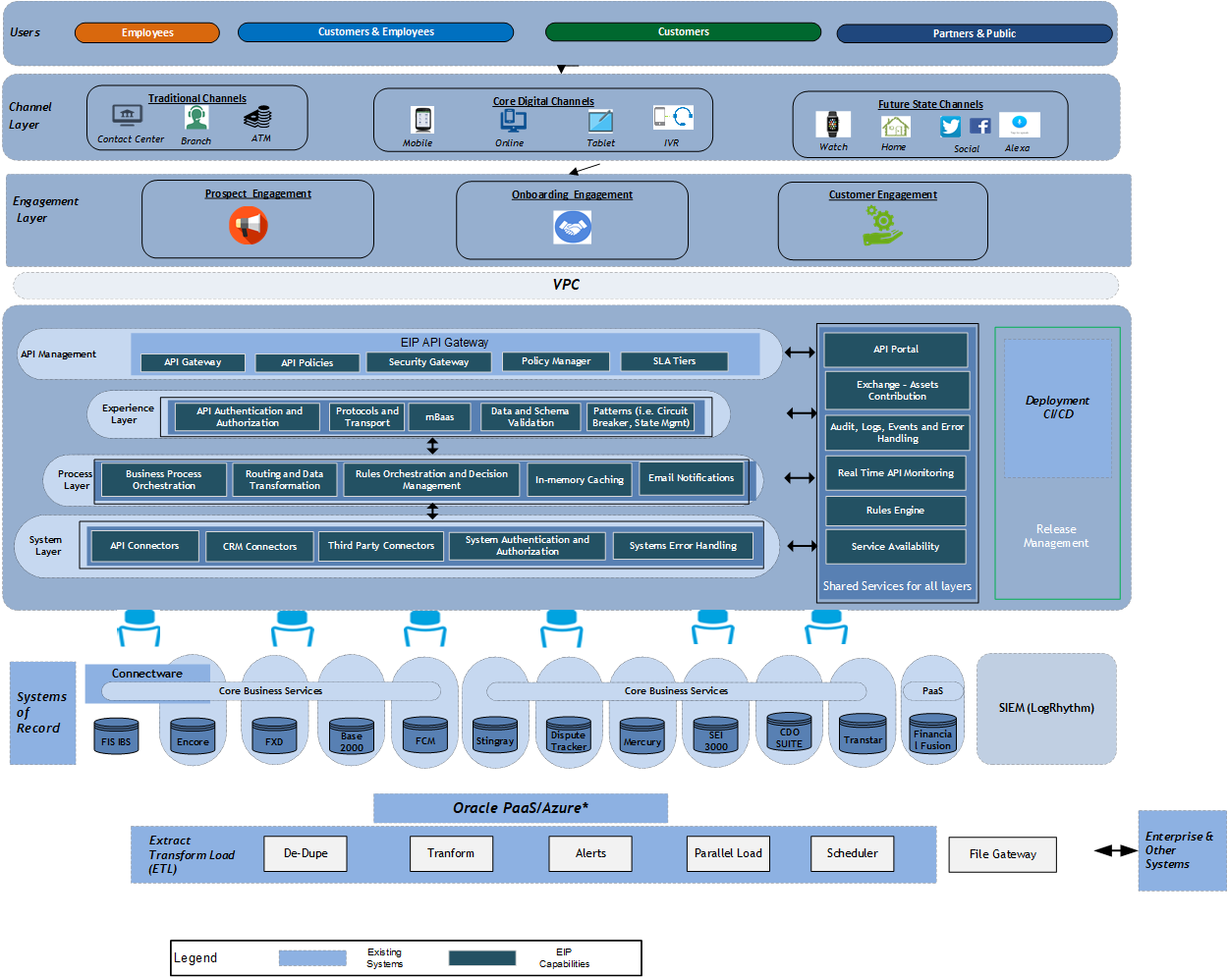
API Led Architecture
Confidential Information for the sole benefit of the recipient
Draft - For Final Review

Slide 14
Definitions
Category | Definition
Reference Data | The Business Area Reference Data contains all categories of managed business reference information, covering subjects including customer details, business partner details and product details. In the case of products it includes aspects of product design, development and quality assurance. It also covers market data feeds for general research and analysis and the range of more specialized trading support market information feeds.
Sales & Service | This business area covers all marketing, business development, customer management and sales and servicing activities. It excludes the fulfillment activities associated with in-force product delivery but includes all customer agreement related activities.
Operations & Execution | This business area includes the full range of product fulfillment activities for wholesale and retail banking, including shared operational capabilities and all front, middle and back office activities.
Product Specific Fulfillment | This Business Domain is a subcategory of the Operations & Execution Business Area that includes all fulfillment and operational tasks associated with the bank's products and services. Product Specific Fulfillment covers the product specific activities associated with the main groups of banking products.
Cross Product Operations | This Business Domain is a subcategory of Operations & Execution that brings together capabilities that tend to be shared across multiple products, often as a centralized operational capability.
Customer Feedback | This Business area, Customer Feedback contains all categories of business surveys, customer complaints and all other related activities.
Confidential Information for the sole benefit of the recipient
Draft - For Final Review

